Slide 1

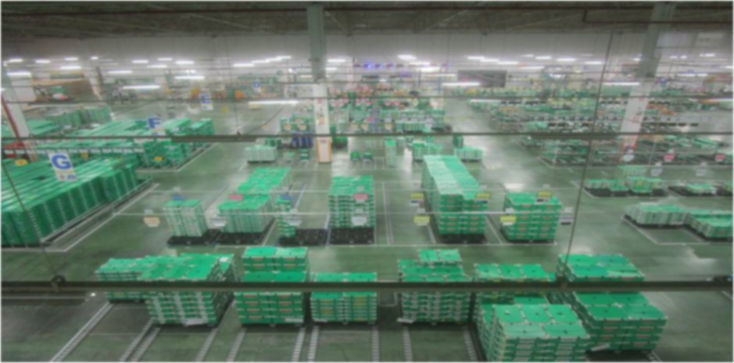

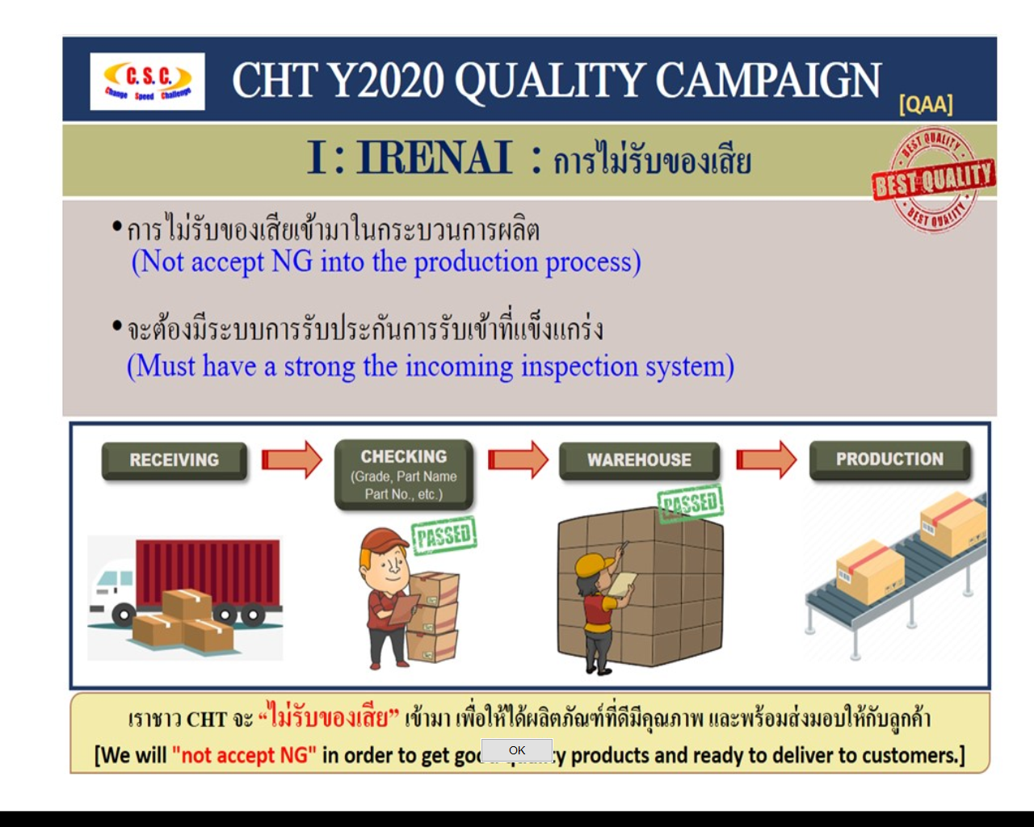
Rec.
SM
Select Color :
LCA
IM
D
omestic
B
utsuryu
C
HOME
About us 
ISO Document 
ontrol
Activity 
IT Project 
Inventory control
Welcome to DBC-RA Website
- Daily stock
- Report
Introduction
Information Schedule
Store control
- Layout
- Report
Admin & Defect control
- ECN
- MT
omestic
D
utsuryu
- EOL
B
C
- Report
ontrol
Milk run
- Supplier milkrun
- Report
Package
- Stock control
- Report
Contact us
© 2020 Developed by Genba-IT : DBC-RA & HT Dept.

Slide 2
Rec.
SM
Select Color :
LCA
IM
D
omestic
B
utsuryu
C
HOME
About us 
ISO Document 
ontrol
Activity 
IT Project 
Inventory control
Welcome to DBC-RA Website
- Daily stock
- Report
Introduction
Information Schedule
Store control
- Layout
- Report
Admin & Defect control
- ECN
D
- MT
omestic
B
- EOL
utsuryu
C
- Report
ontrol
Milk run
- Supplier milkrun
- Report
Package
- Stock control
- Report
Contact us
© 2020 Developed by Genba-IT : DBC-RA & HT Dept.

Slide 3
D
omestic
B
utsuryu
C
ontrol
D
omestic
B
utsuryu
C
ontrol

